Slide 1



MinneMUDAC 2025 Data Challenge
March 2025
Notes:
MORE FORMAL INTRODUCTIONS
For Us: Name, Title, Little Story of Why You’re Here (one-minute)

Slide 2
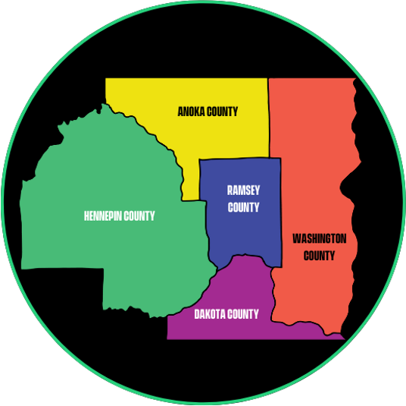

We are Big Brothers Big Sisters Twin Cities!
Youth mentoring organization
Founded in 1920
National Federation of 230 agencies
Twin Cities a Top Ten for # of youth served
Serves the five-county Twin Cities area

Slide 3
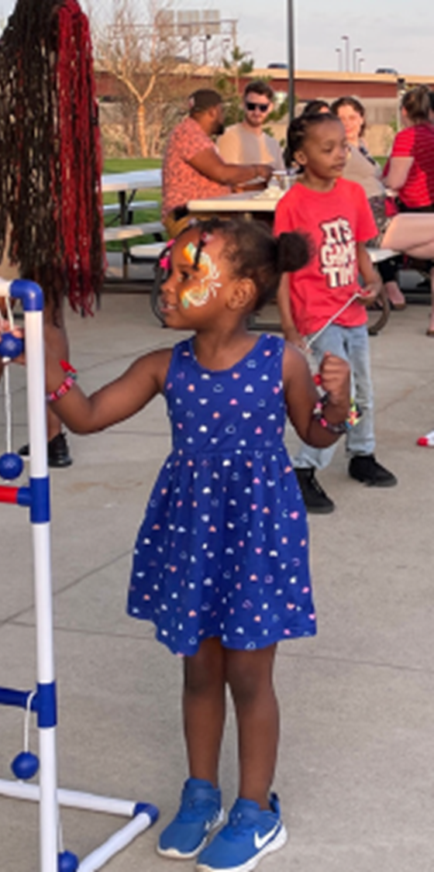
Our Programs
Served 2,200 youth in 2024 through:
Community-Based Program - Challenge Data!
School-Based Program
Big Futures / career and future readiness
Free Arts
1:1 and group mentoring programs

Slide 4
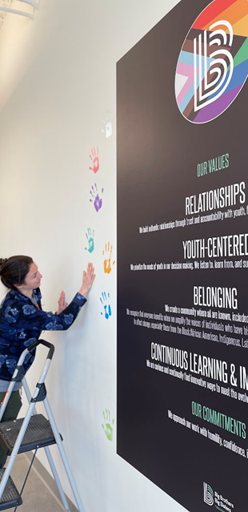
Our community-driven values guide
our decisions, our work, and our impact
Our Mission: Create and support mentoring relationships that ignite the power and promise of all youth
Our Values
Relationships
Youth-Centered
Belonging
Continuous Learning & Improvement
Our Priorities
Engaging Community
Creating Pathways for Youth
Representation
Visualizing Impact

Slide 5
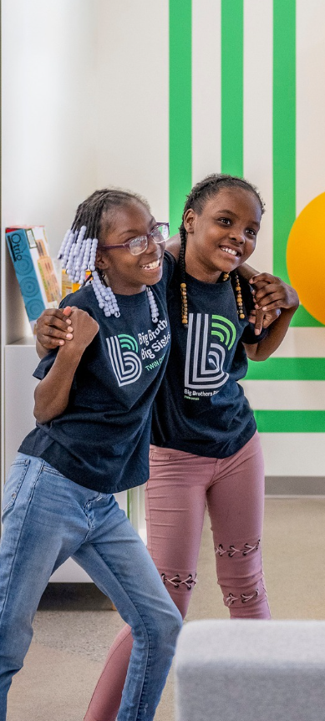
Broad reach
Supported 2,200 youth in 2024
53% female
87% youth of color
76% non-two parent household,
83% low-income
Community-Based average match length of 50 months (14 months longer than national average)
Hosted over 80+ free events in 2024
Partners like Federated Insurance, Securian, 3M, Solventum, Best Buy, Cargill, Target, General Mills, St. Thomas ,U of M

Slide 6

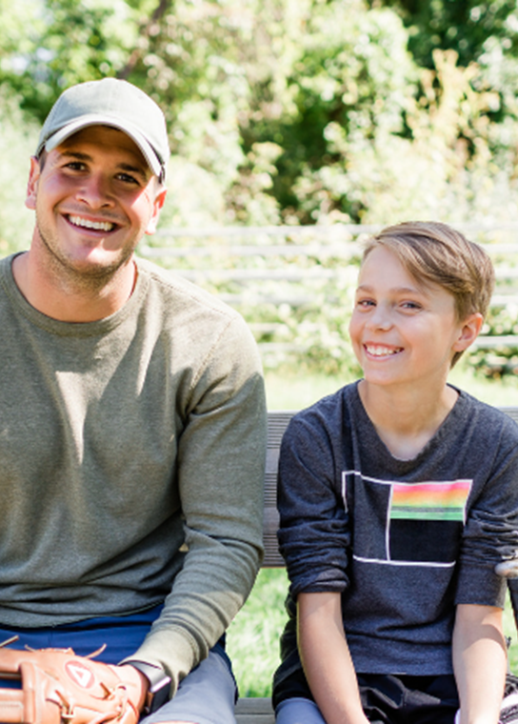
Deep impact on youth
We are built on stories!
93% say their relationship with their Big is very important to them
87% maintained or strengthened their social competence and emotional regulation
89% rated their program experience highly
Recent long-term impact study done with Harvard & the IRS
20% more likely to enroll in post-secondary / college
Eliminates ⅔ of the economic gap
15-20% increase in lifetime earnings
Incredible and lasting ripple effect!

Slide 7

How did we get here?
Thousands of touchpoints
Evolution of non-profit data culture
Stories translated into impact and value
Expertise, creativity, and generosity from all of you!

Slide 8
THANK YOU!
To learn more, donate, or volunteer (be a Big!), please visit BigsTwinCities.org
P.S. YOU WOULD BE AN AWESOME BIG!

